Slide 1
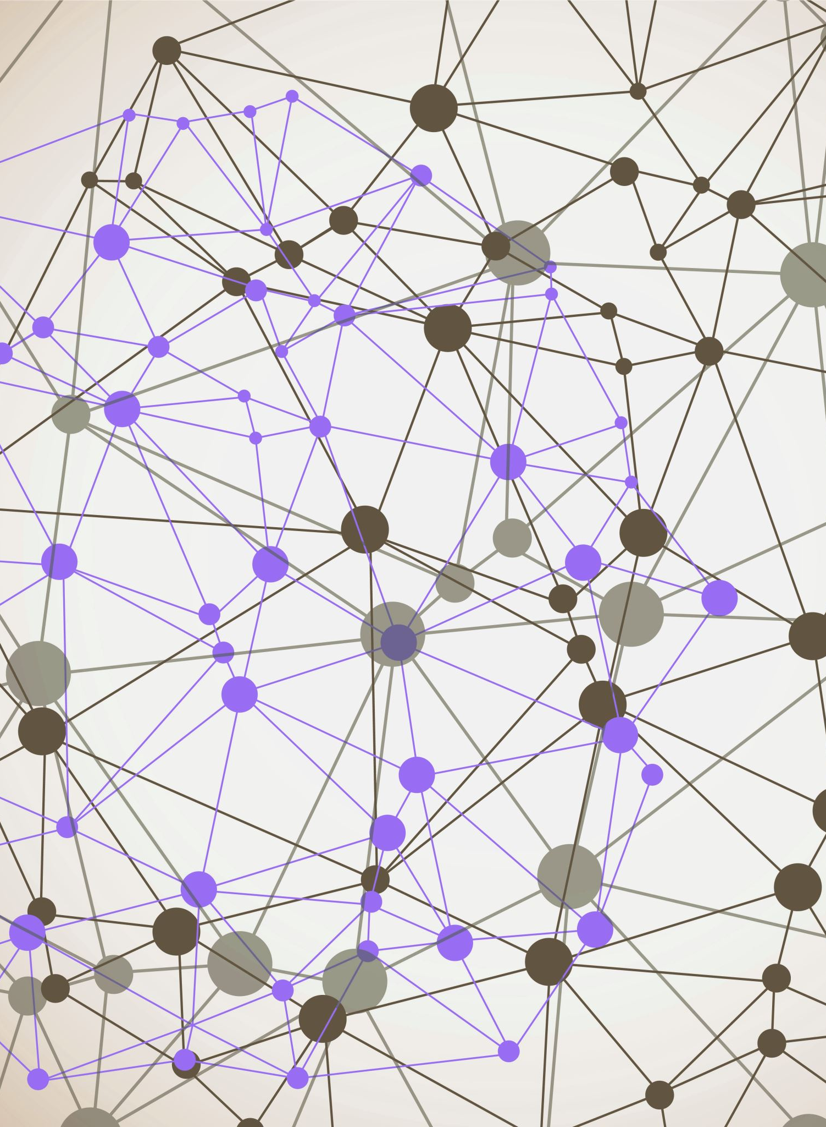
Supermarket sales POV from a Business Analyst
Rabbi Islam Yeasin
Engineer of Computer Science
IBM Certified Professional Data Scientist
Data Science Intern, InternInfoTech
Ex Machine Learning Intern, Mentorness
rabbi.yeasin-arena.com

Slide 2
Problem Statement
The growth of supermarkets in most populated cities are increasing and market competitions are also high. The dataset is one of the historical sales of supermarket company which has recorded in 3 different branches for 3 months data. Predictive data analytics methods are easy to apply with this dataset.

Slide 3
Attributes :
Invoice id: Computer generated sales slip invoice identification number
Branch: Branch of supercenter (3 branches are available identified by A, B and C).
City: Location of supercenters
Customer type: Type of customers, recorded by Members for customers using member card and Normal for without member card.
Gender: Gender type of customer
Product line: General item categorization groups - Electronic accessories, Fashion accessories, Food and beverages, Health and beauty, Home and lifestyle, Sports and travel
Unit price: Price of each product in $
Quantity: Number of products purchased by customer

Slide 4
Attribute (Continues):
Tax: 5% tax fee for customer buying
Total: Total price including tax
Date: Date of purchase (Record available from January 2019 to March 2019)
Time: Purchase time (10am to 9pm)
Payment: Payment used by customer for purchase (3 methods are available –
Cash, Credit card and Ewallet)
COGS: Cost of goods sold
Gross margin percentage: Gross margin percentage
Gross income: Gross income
Rating: Customer stratification rating on their overall shopping experience (On a scale of 1 to 10)

Slide 5




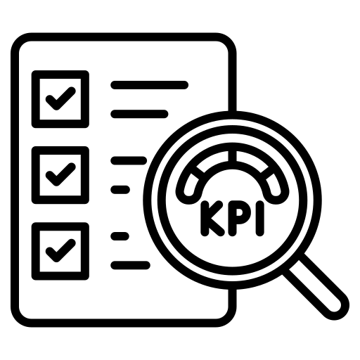

Work Steam
Data Collection
Feature Engineering
Data visulization
Customer
Analysis
Report Export
EDA

Slide 6





Tech Stack
Python
Numpy
Mathplotlib
Pandas
Seaborn

Slide 7
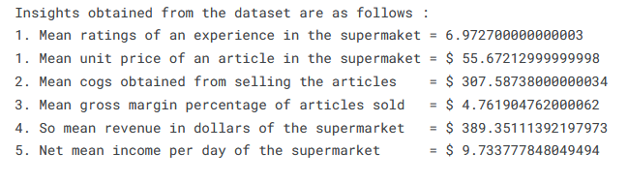
Insights from the Raw Dataset

Slide 8
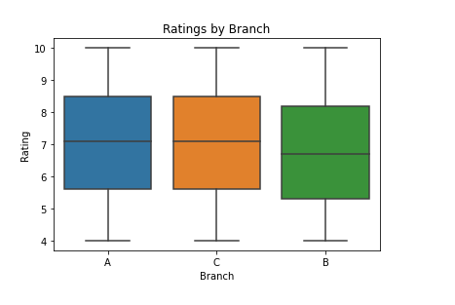
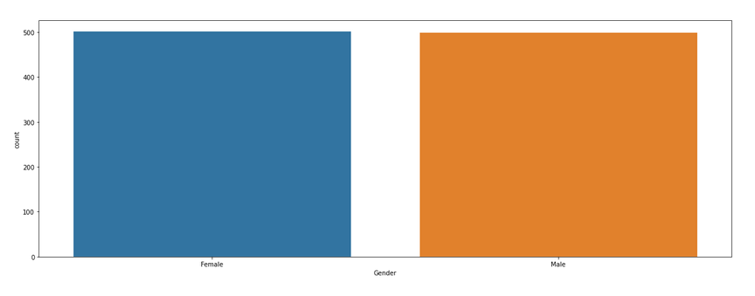
Proportion (Gender wise) & Branch Rating
Insights:
Gender wise Females went more than Males in a Super shop
Among Three Branchs “Branch B” is less popular than average

Slide 9
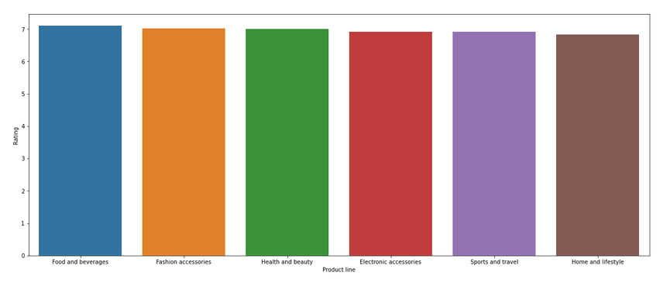
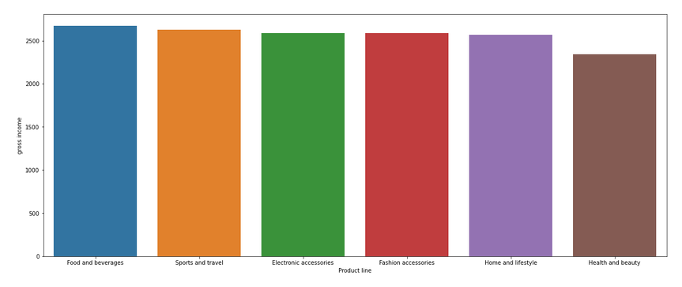
Variation in Product Line Vs Gross income
Insights:
Negligible variation of rating across product line
Gross income is more in Food and bevarages.
However,Health and supply need some good caring

Slide 10
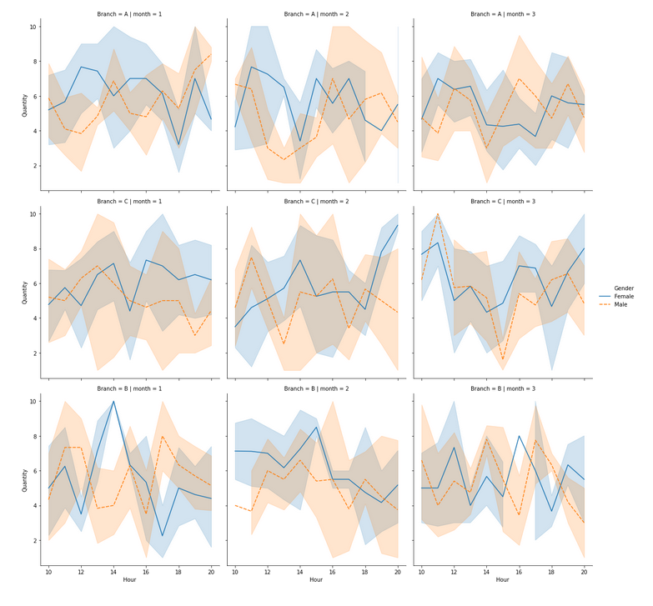
A detailed plot of every branch's Quantity during the three month of time period presented by females and males

Slide 11
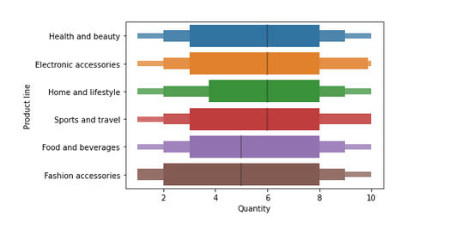
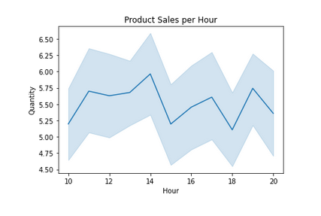
Quality-Rating Vs Hourly Sale
Insights:
Peak was achieved during the 14th hour of the day, So more quantity is been sold in Afternoon
Here we can interpret that food and bevarages, fashion accesories has less mean quantity
whereas we have seen that both of these categories had high rating.
So we need to increase our supply, matey.

Slide 12
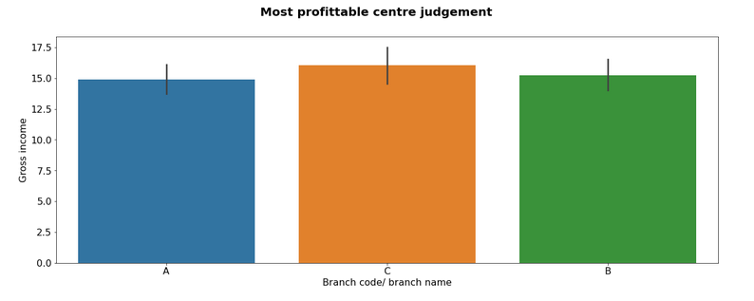
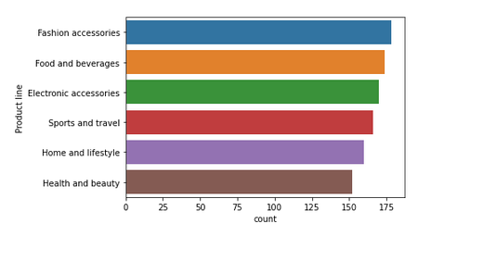
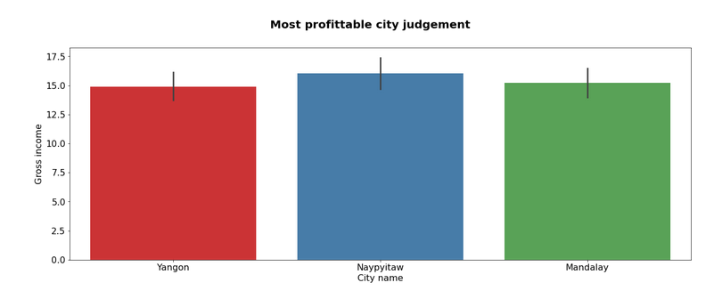
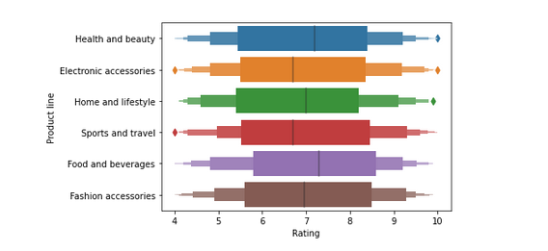
Relation Between Sales Center Vs Popurality

Slide 13
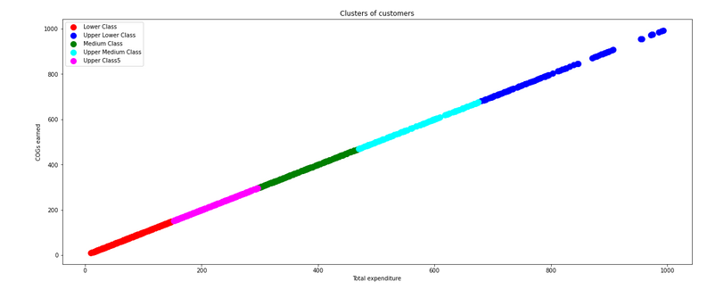
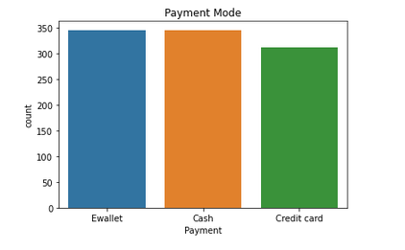
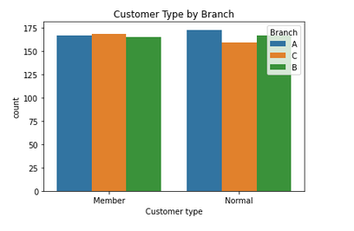
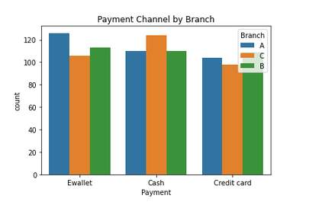
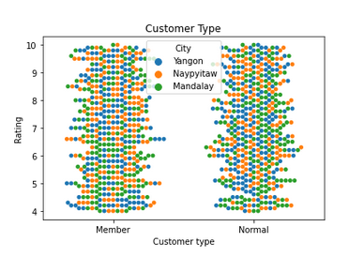
Customer & Cashflow
Insights of –
Customer Clustering
Payment Mode and Channels
Customer Type via Cities and Branchs

Slide 14
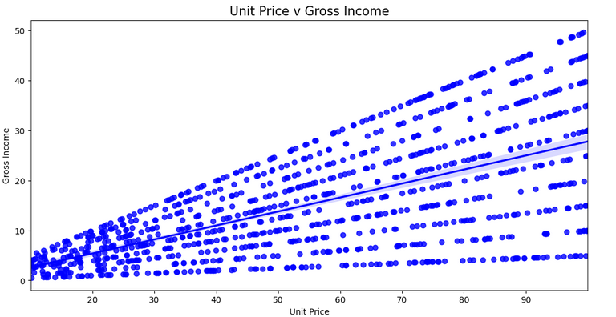
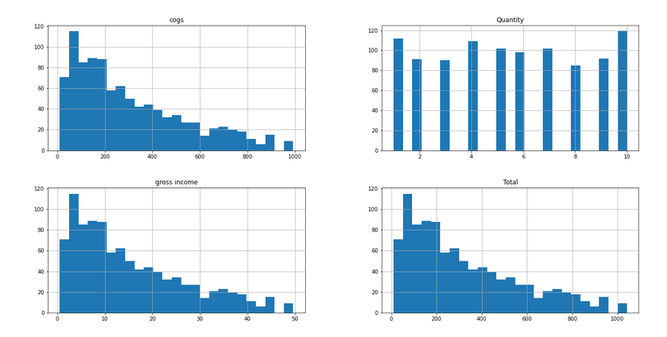
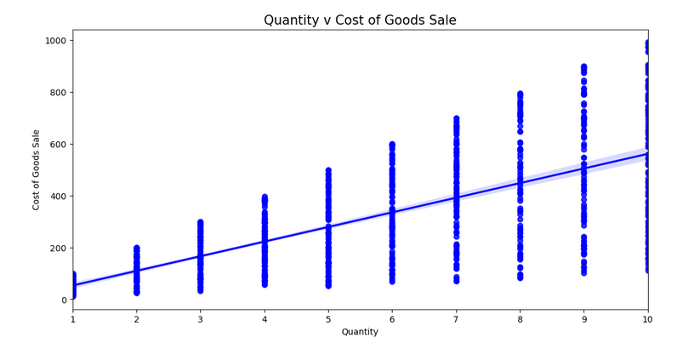
Unit Price Vs Gross Income Quality Vs Cost of Goods Sale

Slide 15
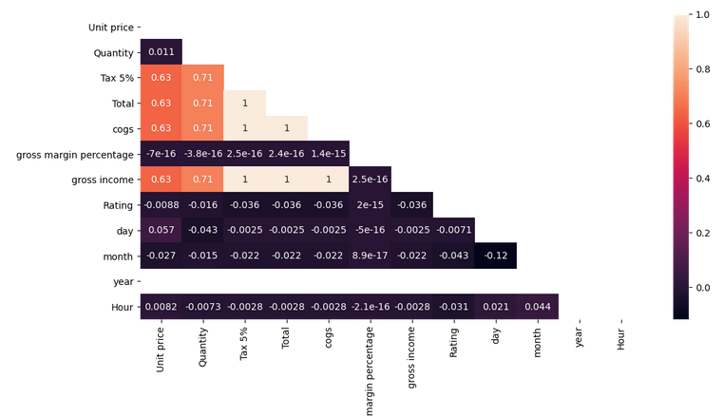
Glimpse

Slide 16
Some Business Observation
In Customer Clustering : Precisely saying, red coloured cluster represents economically lower class of customers and blue cluster represents economically stronger group of customers
Yangon leads at Home & Lifestyle and Electronic accessories.
Naypyitaw leads at Food & Bevaerages and Fashion accessories.
Mandalay leads at Sports & Travel and Health & Beauty.

Slide 17
FINAL COMPLETE BUSINESS REPORT
The city chosen for expansion should be Naypyitaw.
Open the store in Naypyitaw with a full-backed inventory of goods in product categories - Food and Beverages, Fashion Accessories and Electronics.
The company should improve service in Electronics domain.
Increase service in cash payment modes.

Slide 18





Thank You
Rabbi Islam Yeasin
Engineer of Computer Science
IBM Certified Professional Data Scientist
Data Science Intern , InternInfoTech
Ex Machine Learning Intern, MentorNess

